Slide 1

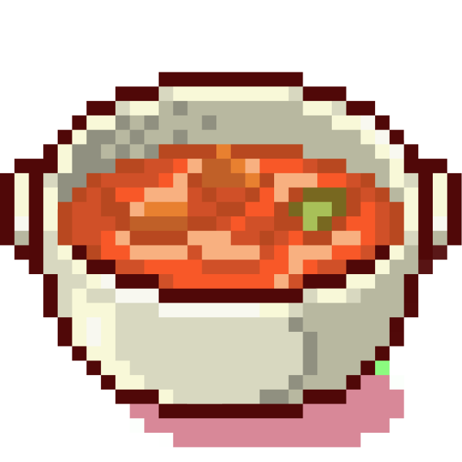




Controversial opinion
Is chilli a soup?

Slide 2

Controversial opinion
YES.

Slide 3




Controversial food opinions
Are stews
soups?

Slide 4
Controversial food opinions
YES.

Slide 5
Definition of soup
Soup (noun)
A food made by cooking vegetables, meat, or fish in a large amount of liquid.

Slide 6
Definition of stew
Stew (noun)
Fish or meat usually with vegetables prepared by stewing.

Slide 7
Definition of stew as a verb
Stew (verb)
To boil slowly or with simmering heat.

Slide 8
You boil things in liquid.

Slide 9

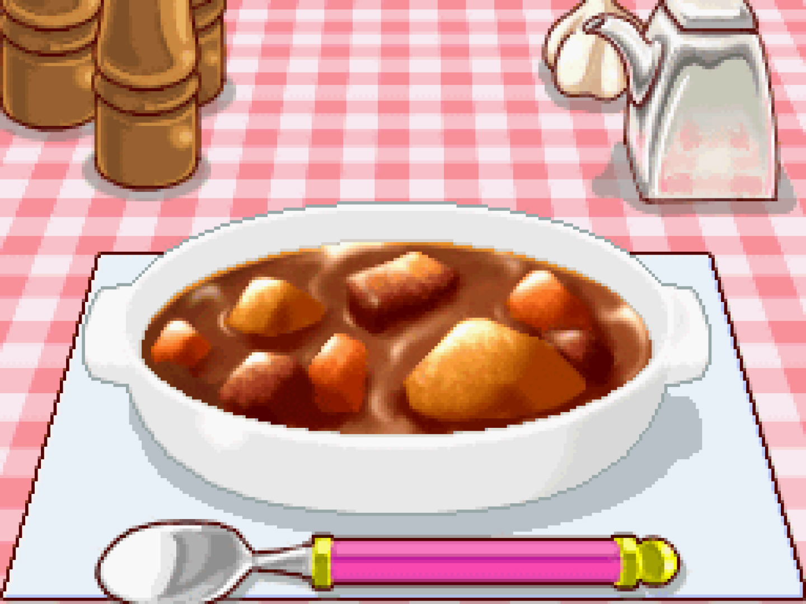

This is a stew

Slide 10
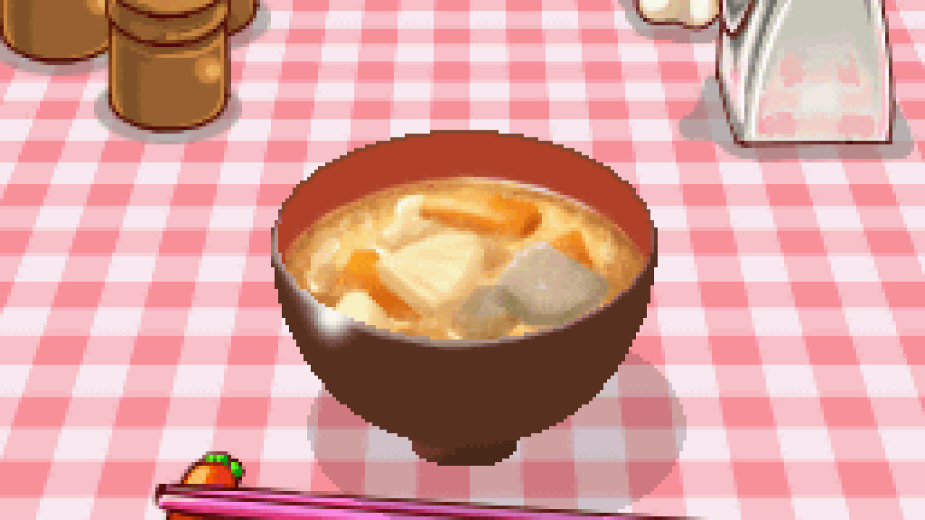
This is a soup

Slide 11
“Is chilli a soup?”
1. Is chilli a stew? Yes.
2. Are stews soups? Yes.
3. Chilli = Soup

Slide 12
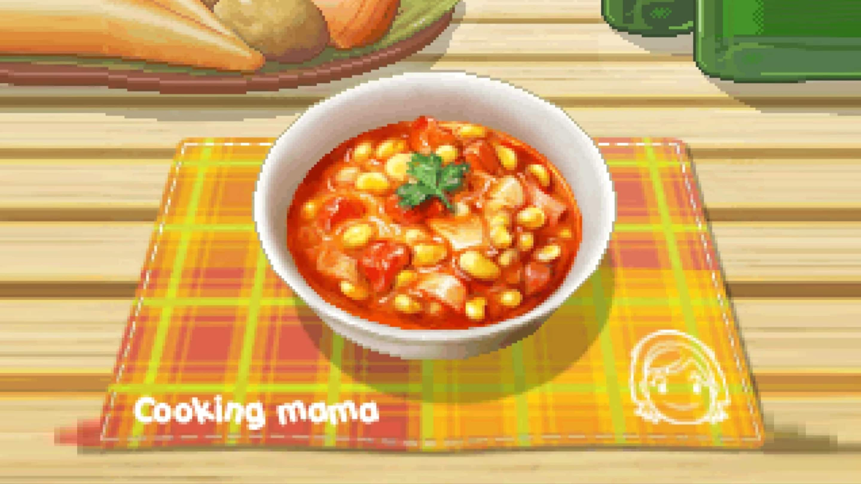

Therefore, chilli is soup

Slide 13


Thank
You

Slide 14
Boom.

Slide 15
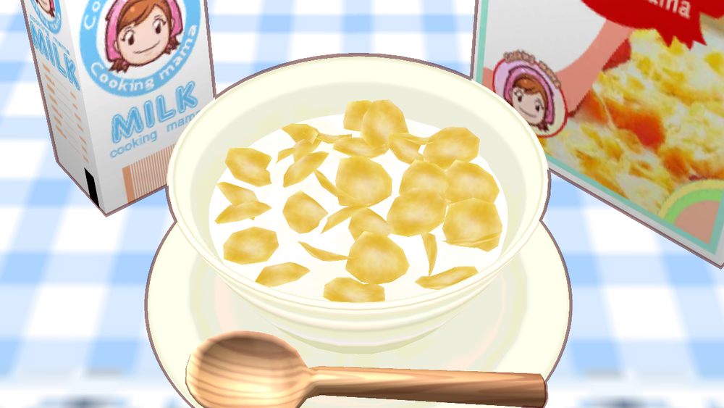
Is cereal soup?

Slide 16
“Cereal is a soup”
Shut the fuck up.

Slide 17
“Cereal is a soup”
You don’t COOK cereal

Slide 18








Slide 19









Slide 20
Title

Slide 21
Title

Slide 22
A hotdog consists of bread and filling, similar to many sandwiches. Bread functions as a structural element in both dishes.
3 reasons why a hotdog a sandwich

Slide 23
Like sandwiches, hotdogs are designed to be eaten with hands, making them more portable and convenient option for on-the-go meals.
3 reasons why a hotdog a sandwich

Slide 24
Hotdogs and sandwiches have similar preparation technique: assembling ingredients between bread or rolls, adding condiments and toppings, and sometimes toasting or grilling
3 reasons why a hotdog a sandwich

Slide 25
Are fries a vegetable?
Fries are typically made from potatoes, which are a root vegetable
They still retain certain nutrients found in vegetables, such as vitamin C and potassium

Slide 26

Is a smoothie a soup?
Both involves blending together various ingredients, such as fruits, vegetables, yogurt, or milk, creating a mixture with a unified flavor and texture.

